Slide 1


SALES ANALYSIS REPORT 2013/2014
MICHAEL CHISOM FORTUNE

Slide 2

Executive Summary
SITUATION
Product category experienced inflation as value for manufacture sales grew, volume sales declined.
COMPLICATION
Markers, note pad and stapler had loses in Government, Enterprise, Midmarket and Channel Partners.
QUESTION(S)
What products share loss across the states?
How do we continue to drive growth for our key products?

Slide 3
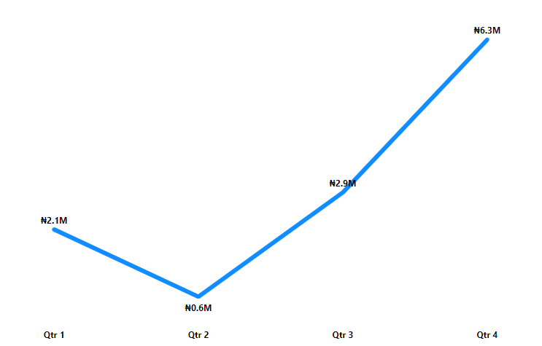
REVENUE TREND 2014
At Qtr. 4 had the highest profit for the year.
Qtr. 2 had the lowest profit for the year.
Qtr. 4 accounted for 52.40% of Profit. ﻿

Slide 4
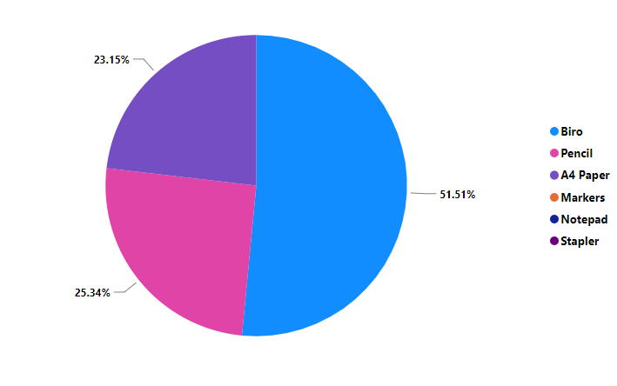
REVENUE CONTRIBUTION (%) PER CATEGORY
Biro accounted highest value of Revenue for 51.51%.
A4 paper accounted the lowest value of Revenue for 11.63%

Slide 5
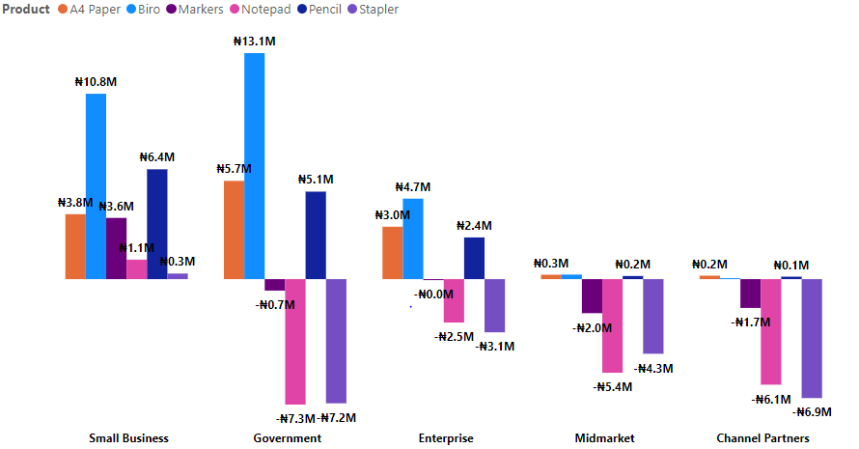
TOTAL PROFIT BY PRODUCT AND SEGMENT
Small Business had no lose in Product.
Others segments had loses in Markers, Note pad and Stapler.
Government in Product made up 12.12% of PAT.﻿

Slide 6
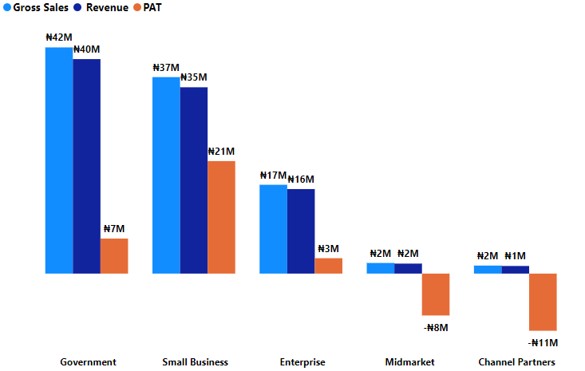
REPORT OVERVIEW FOR SEGMENT
Government had the highest Revenue and Gross Sales.
Small business had the highest PAT.
At Channel Partners and Midmarket suffered losses.

Slide 7
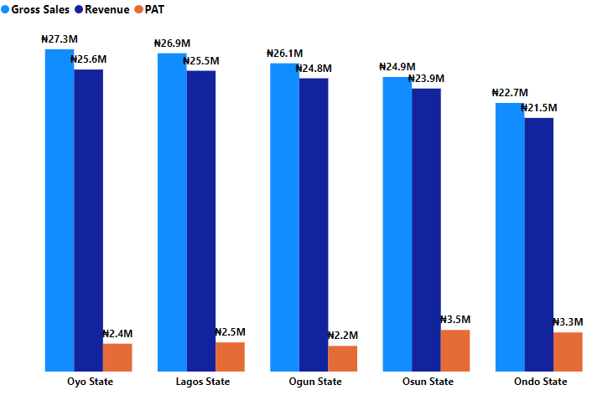
REPORT OVERVIEW FOR STATE
Oyo state had the highest gross sales and revenue.
Osun state had the highest PAT.
﻿Gross Sales and total Revenue are positively correlated with each other.﻿

Slide 8
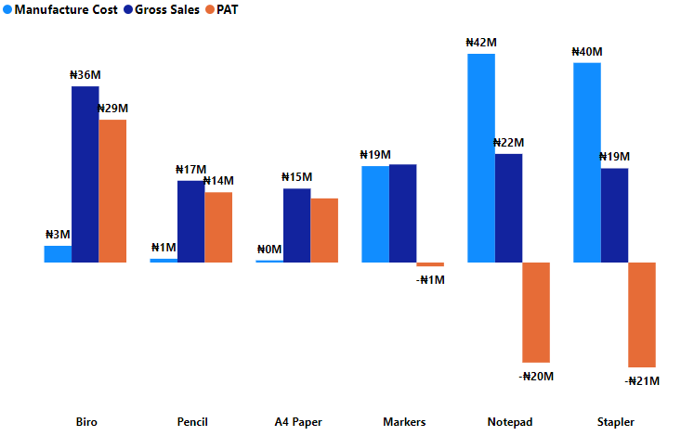
REPORT OVERVIEW FOR PRODUCT
Biro had one of the lowest manufacture cost but had the highest Gross sales and profit.
Note pad and Stapler both had high significant amount for manufacture cost and gross sales but suffered losses. ﻿ ﻿

Slide 9
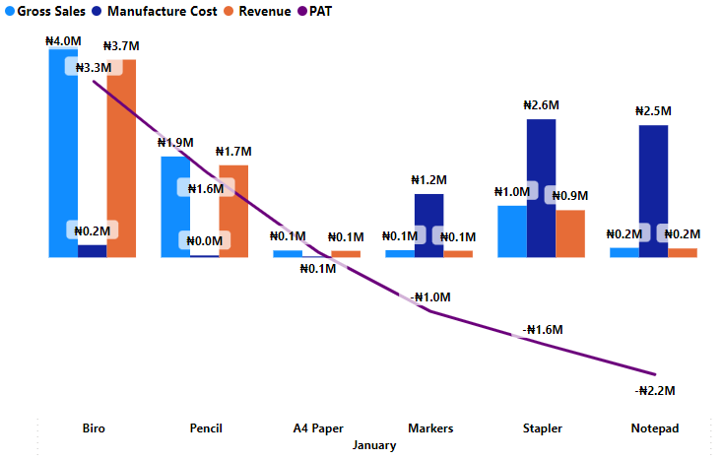
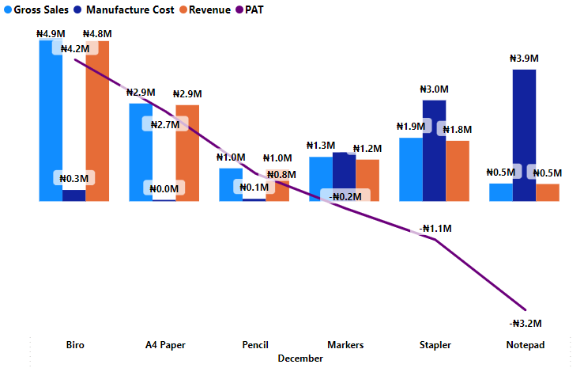
PRODUCT ANALYSIS FOR JAN. AND DEC. 2014
﻿Gross Sales and total Manufacture Cost are negatively correlated with each other in January and December.﻿
Markers, Stapler and Notepad products recorded losses in both Months.
﻿ January Products made up 54.40% of Gross Sales.﻿ December Products made up 38.90% of Gross Sales.﻿

Slide 10
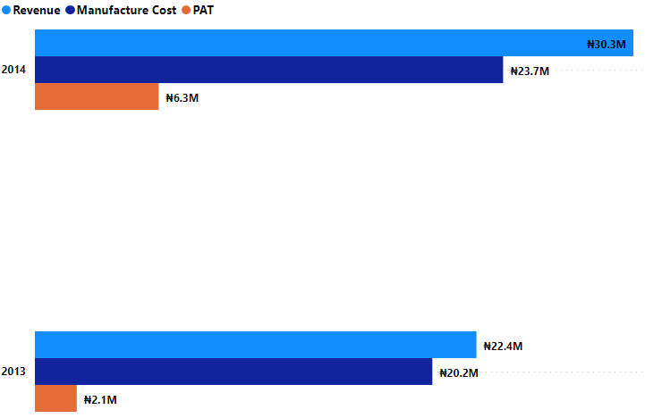
HIGHLIGHT ON 2013 AND 2014 (QTR4)
Revenue and Manufacture both generated high revenue in 2014 and 2013 .
At 2014 profit of ₦6.3M was accounted for Qtr. 4.

Slide 11
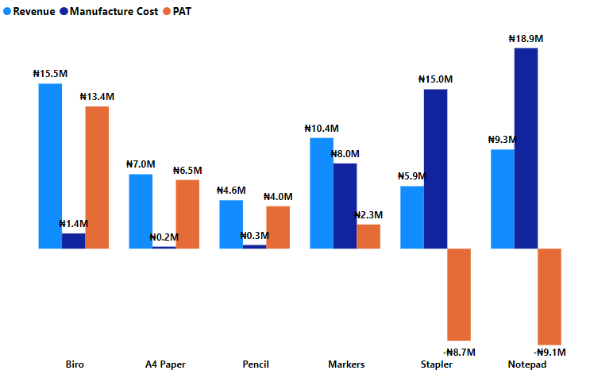
HIGHLIGHT ON 2013 AND 2014 (QTR4) BY PRODUCT CATEGORY
At Qtr. 4 for year 2014 and 2013, Biro had the highest revenue than Pencil, which had the lowest revenue.
﻿Biro accounted for 29.45% of Revenue.

Slide 12
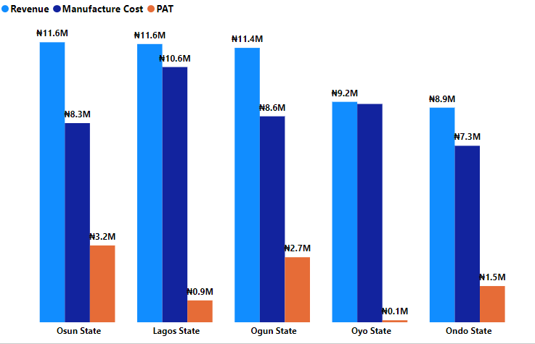
HIGHLIGHT ON 2013 AND 2014 (QTR4) BY STATE
﻿Revenue and total Manufacture Cost are positively correlated with each other.﻿
Osun state and Lagos State accounted for ₦11.6M of highest Revenue.﻿
Oyo state had the lowest Profit.

Slide 13
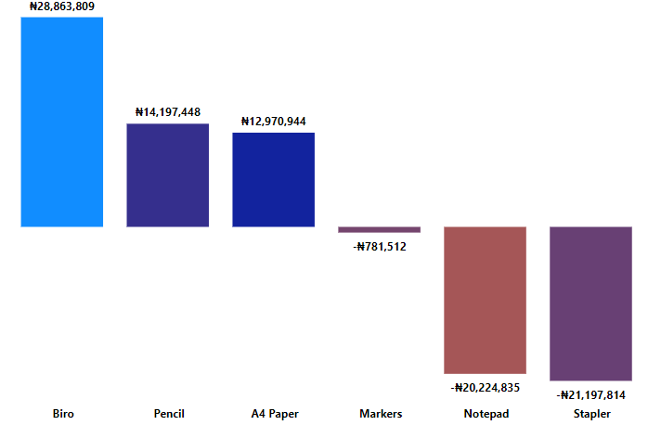
PROFIT BY PRODUCTS
Key products that generated high PAT are Biro, Pencil and A4 Paper

Slide 14
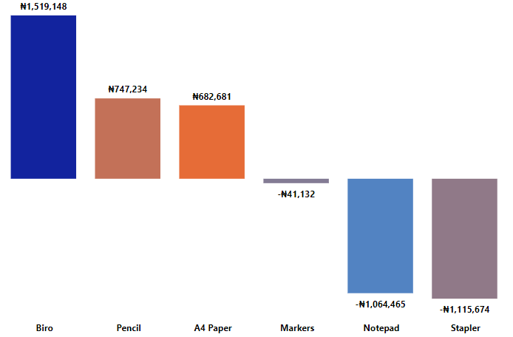
OVERALL TAX ON PRODUCTS
﻿At ₦1,519,148 Biro had the highest Tax and was 236.16% higher than Stapler, which had the lowest Tax at -₦1,115,674.﻿

Slide 15
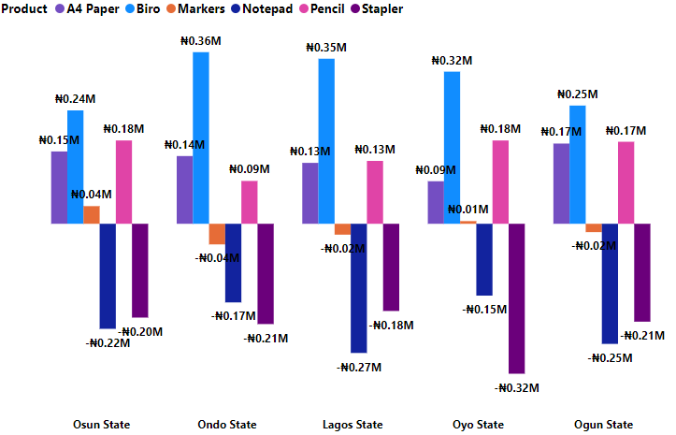
OVERALL TAX ON PRODUCTS BY STATE
Ondo State in Product made up 6.89% of Sum of Tax.
Ondo State, Lagos State and Ogun State all recorded lowest Tax for Marker, Notepad and Stapler.

Slide 16
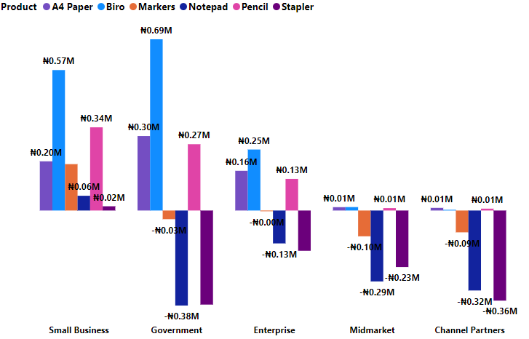
OVERALL TAX ON PRODUCTS BY SEGMENT
﻿ ﻿Government in Product made up 12.12% of Tax.﻿
﻿Government, Enterprise, Midmarket and Channel Partners all had lowest Tax for Markers, Notepad and Stapler.

Slide 17
RECOMMENDATION
From the data analyzed, its advisable to discontinue products on Note pad and stapler due to poor returns and increase in manufacturing cost.
An Increase in the manufacturing cost on A4 paper next year could have a better impact on both revenue, PAT.
More focus on 2014 should be on Biro, A4 Paper and pencil.
R&D Department should focus on what could be the reason for the staggering performance on Marker.

